Slide 1

Semantic Kernel
Where simplicity meets productive AI
S E M A N T I C K E R N E L / Microsoft confidential

Slide 2

Shawn Henry
Semantic Kernel

Slide 3




Semantic Kernel is lightweight, open-source, production-ready, orchestration middleware that lets you easily add AI to your apps.
Python
Java
.NET

Slide 4

Semantic Kernel was built specifically for enterprise app developers.

Slide 5































Semantic Kernel AI and Agent Orchestration
AI Services
 | Azure OpenAI |  | Foundry Catalog
 | OpenAI |  | Hugging Face
 | NVIDIA |  | Deepseek
 | Google Gemini |  | AWS Bedrock
Agent Services
 | Azure AI Agent Service |  | Bedrock Agents
 | AutoGen |  | Crew AI
Plugins
 | OpenAPI |  | MCP
 | Container Apps |  | Logic Apps
Local models
 | Ollama |  | ONNX
 | LM Studio |  | Phi SLM Model Family
Prompts
 | YAML |  | Semantic Kernel
Memory Services
 | Azure AI Search |  | Azure CosmosDB
 | Elasticsearch
 | MongoDB |  | Pinecone
 | Qdrant |  | Redis
Filters and telemetry
 | OpenTelemetry |  | Azure Monitor
 | Aspire Dashboard |  | Azure AI Content Safety
Z
.NET
Python
Java

Slide 6



Agentic AI
Reason over a provided business process
Models
AI agents can plan, adapt to new information, and execute tasks independently, making them capable of handling complex, dynamic environments, decision-making and autonomous action. They can learn from feedback, adjust their strategies, and operate with minimal human oversight.
Retrieve context to complete the process
Memory
Perform an action for the end-user
Tools

Slide 7
Semantic Kernel is “agent-first”
Models
Context
Memory
Plugins
Agent
Agent
Agent
Agent
Agent
LOB Apps
Biz Ops
New APIs
New Agents
New Value
New Value
New Value
New Value

Slide 8
DEMO Build an agent with Semantic Kernel https://aka.ms/sk/hacks

Slide 9
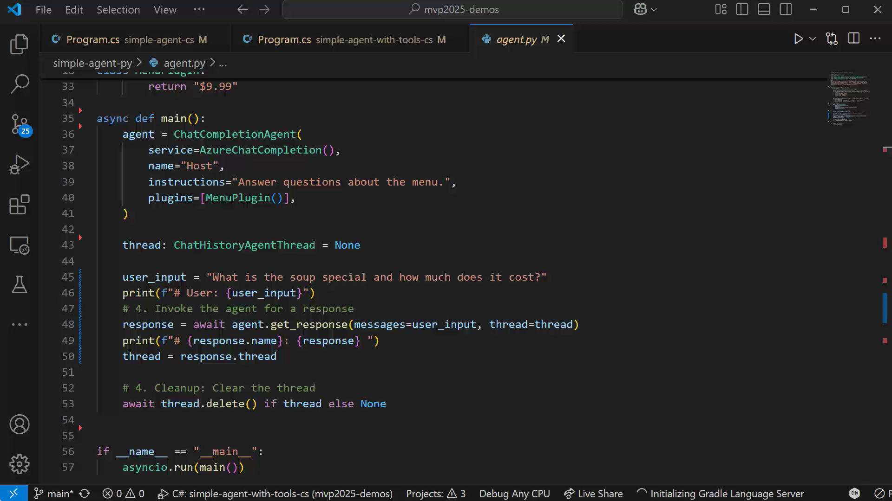

Slide 10









Spectrum of Agentic Solutions
Memory
history of work
User Proxy Agent
CoordinatorAgent
LLM
Agent
LLM
conversation
LLM
question
query
data
prompt +
data
prompt
answer
Service
Agent
LLM
Retrieval
Agent
LLM
Analytics
Agent
S
LM
Coding
Agent
SLM
document
summary
Search
docs
input
output
query
data
data
Web Service
Search
databases
docker
docs
No Agent
Very narrow one shot task
Ex: log to JSON
Single Agent
Very clearly scoped iterative task
Ex: providing an answer with supporting evidence to a complex question
Multi-agent Systems
Wide scope complex use case requiring diverse skills
Ex: Propose 2 Instagram marketing campaigns including assets that would leverage the top 2 recent trends in our past quarter US Sales to boost our mailing list user base and predict the impact of each campaign

Slide 11
Agents are becoming more capable

Slide 12
When should I use multi-agents over a single agent?
Multi agent systems can solve more complex tasks

Slide 13
DEMO Build a multi-agent system with Semantic Kernel https://aka.ms/sk/hacks

Slide 14
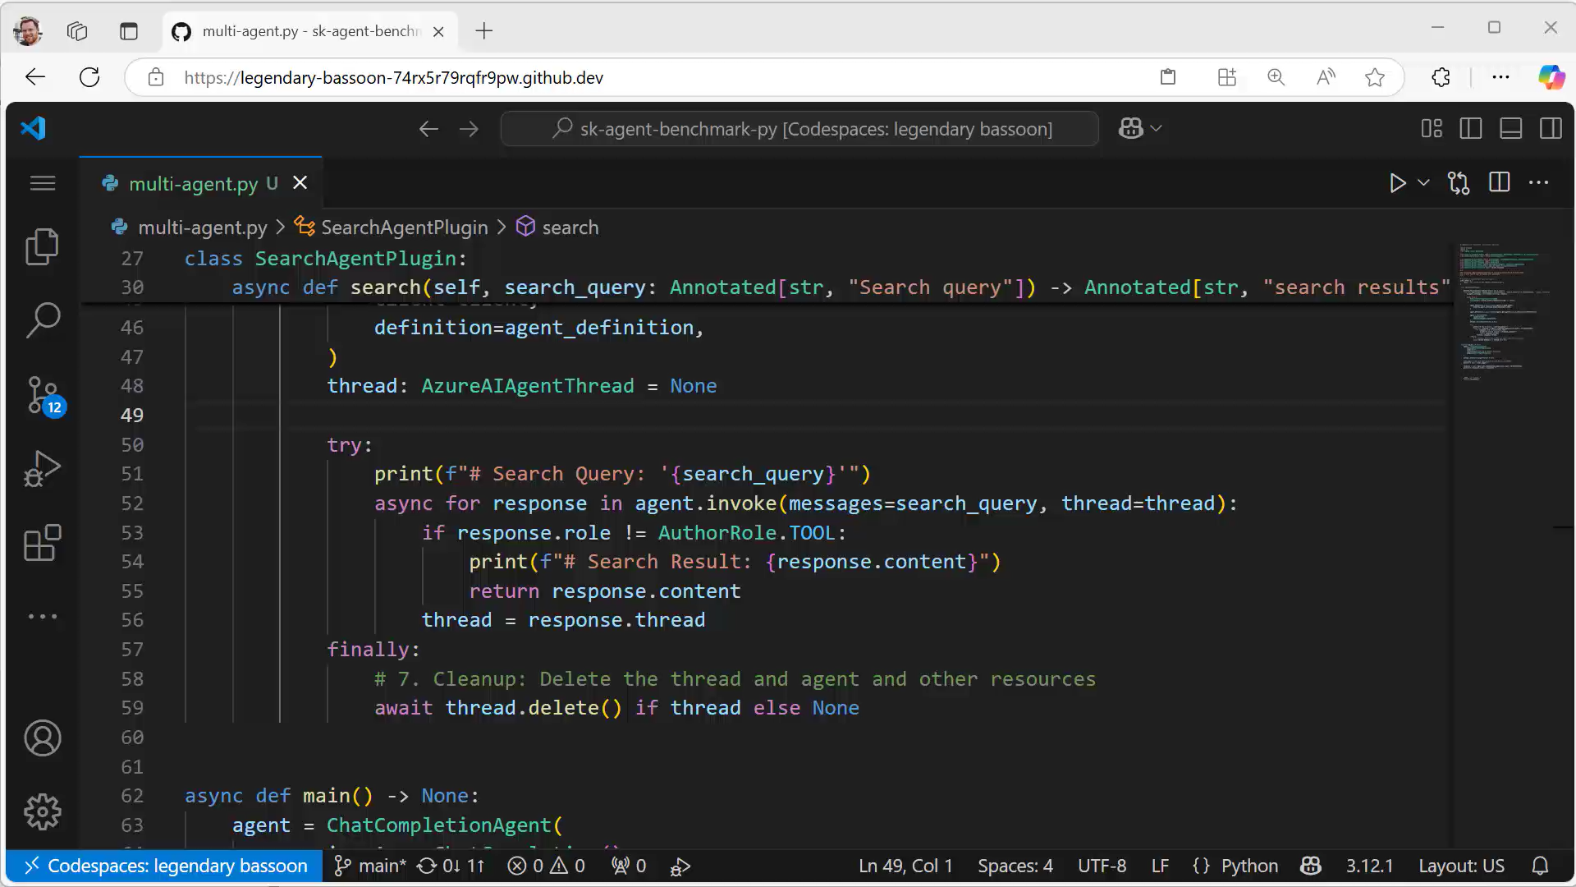

Slide 15


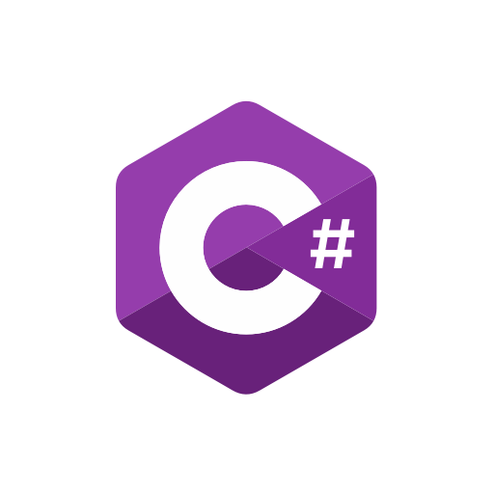

Microsoft’s agentic frameworks
Orchestrate agents with AutoGen and Semantic Kernel
Deploy them with Azure AI Foundry
State-of-the-art research SDK
Production-ready and stable SDK
Managed agent micro-services
Ideation
Production

Slide 16
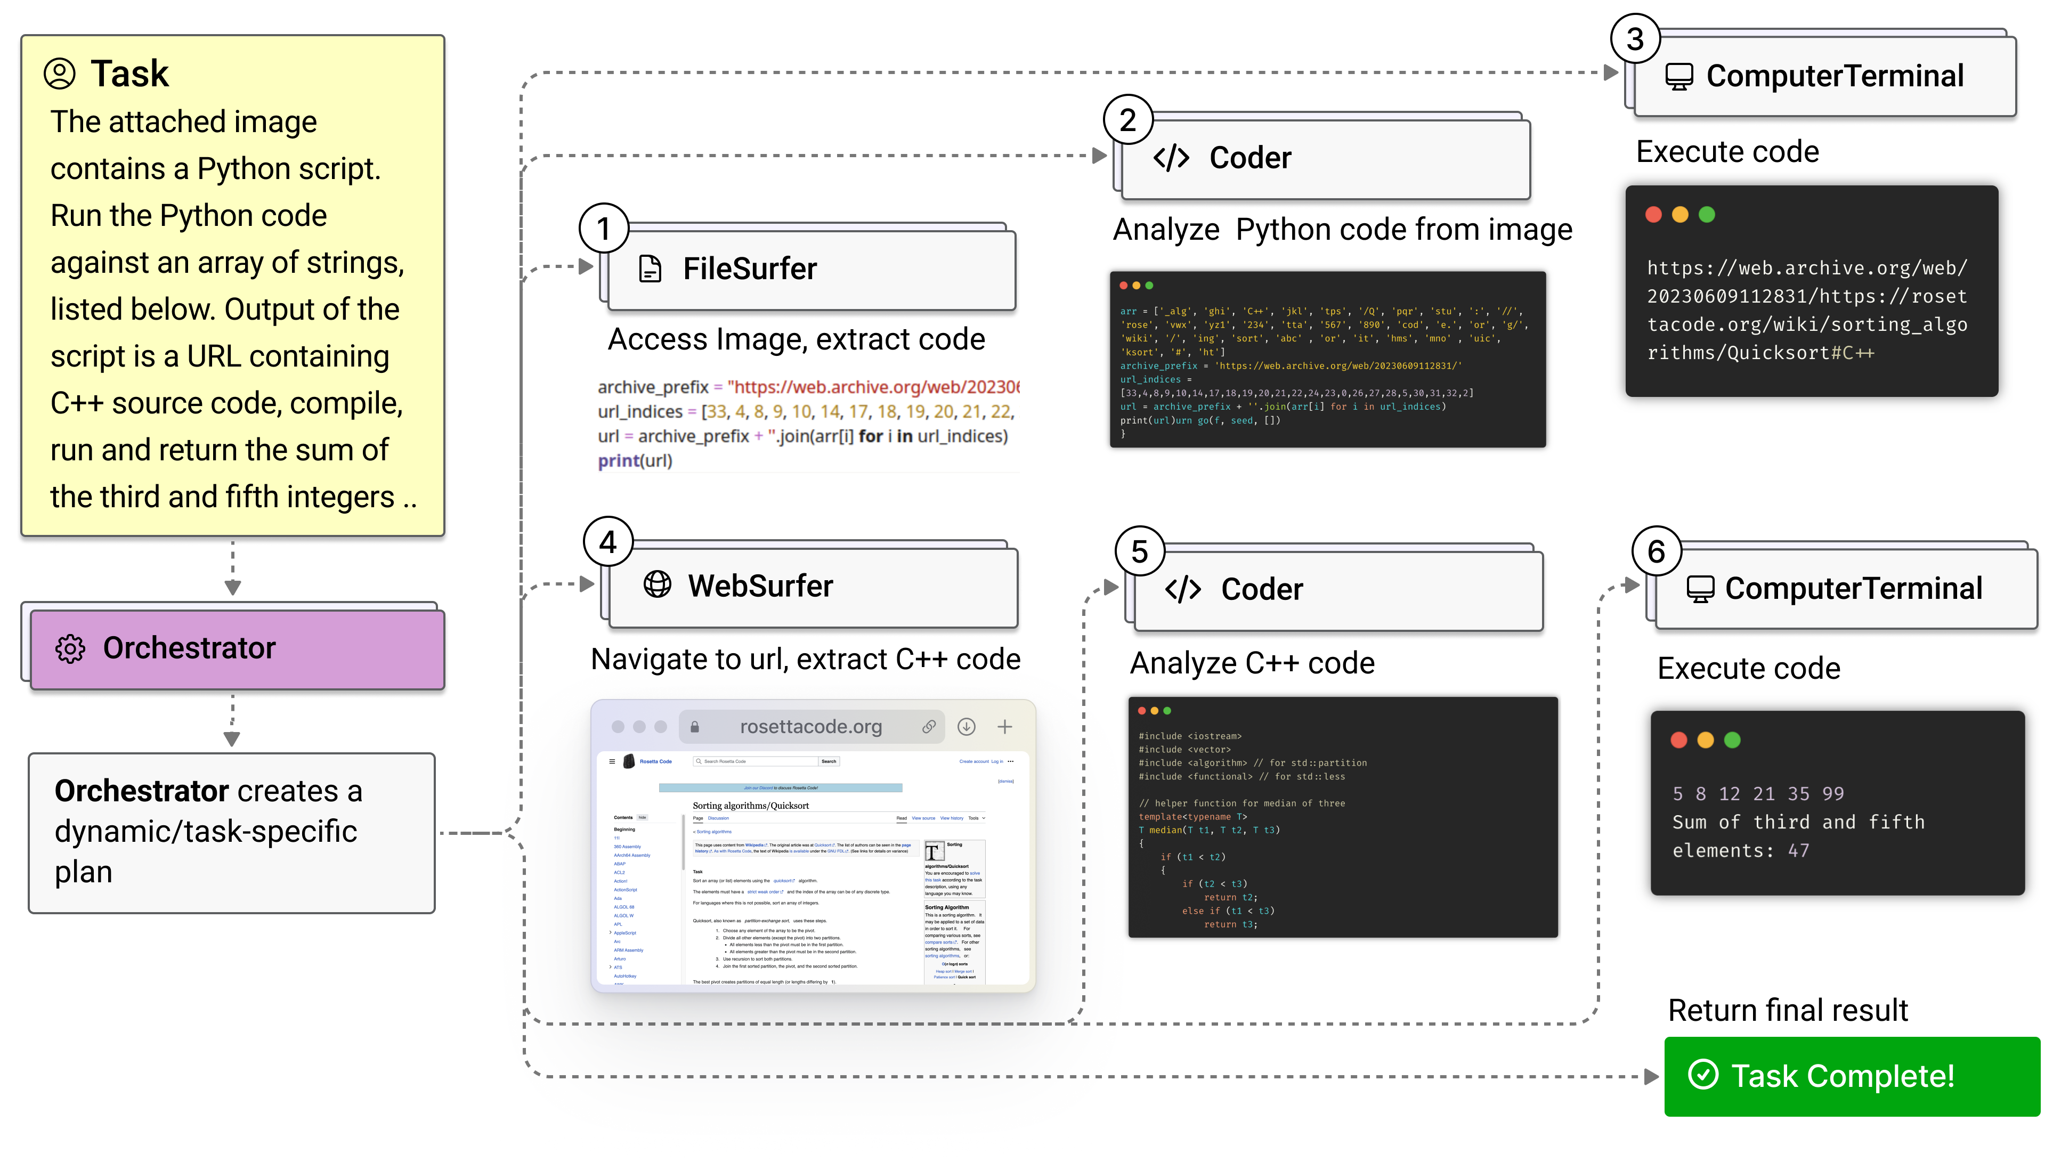
Magentic One

Slide 17
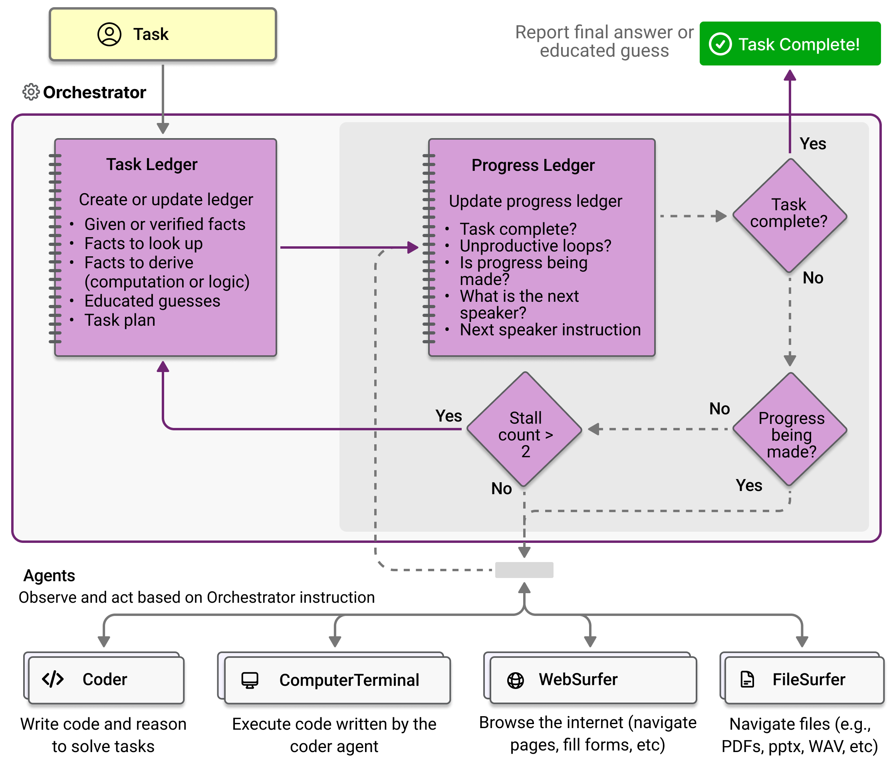
Magentic One

Slide 18
DEMO Magentic One with Semantic Kernel https://aka.ms/sk/hacks

Slide 19
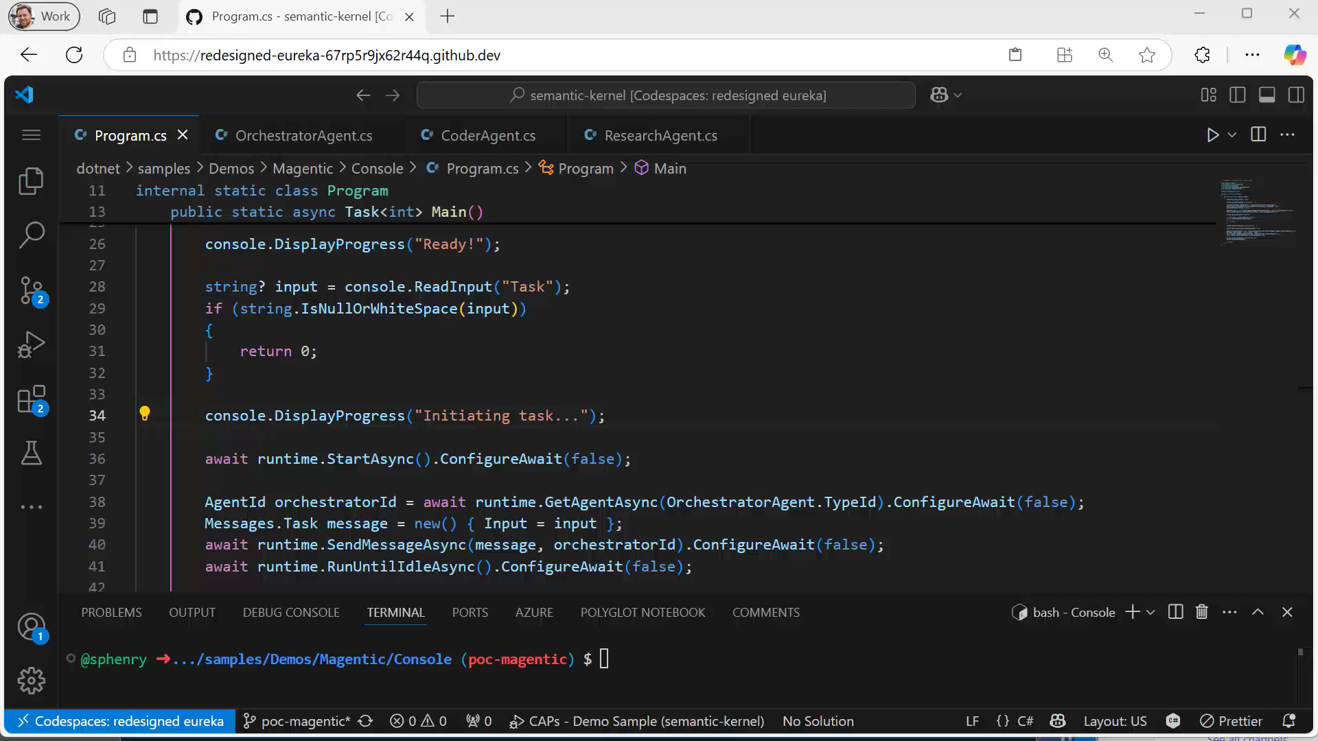

Slide 20
Deep Research Multi-agent Process
Generate Outline
Research and Generate Sections
Compile and Generate
SectionWriterAgent
(Introduction)
WebQueryAgent
Reasoning Model
WebSearchTool
User Proxy Agent
SectionWriterAgent
(Section 1)
OutlineAgent
EditorAgent
SectionWriterAgent
(Section 2)
WriterAgent
conversation
SectionWriterAgent
(Section 3)
Author/Critic
WebQueryAgent
CriticAgent
Human-in-loop
SectionWriterAgent
(Conclusion)
WebSearchTool
Tools and Plugins
Fan Out
Subprocess

Slide 21
DEMO Realtime Audio https://aka.ms/sk/hacks

Slide 22



What’s Next?
Agentic Path
Single Agent
Multi-Agent
Agentic Enabled Business Process
For Specific Tasks
For Complex Tasks
For Deterministic, Stateful Processes

Slide 23
What’s Next?
More things to try:
Build connectors to AWS Bedrock Agents, Crew AI or AutoGen | https://aka.ms/sk/bedrock-agents https://aka.ms/sk/autogen-agents
Connect to Copilot Studio agents | https://aka.ms/sk/copilot-agent
Use a Semantic Kernel as a Copilot Studio skill | https://aka.ms/sk/copilot-skill
Build Azure AI Agents that execute code, do file search, or search the web | https://aka.ms/sk/azure-agents
Use local models with Ollama | https://aka.ms/sk/ollama
Add logging and telemetry | https://aka.ms/sk/agent-logging https://aka.ms/sk/agent-telemetry

Slide 24






Try
Learn
Join
Git Hub Repo
https://aka.ms/sk/repo
Learn Site
https://aka.ms/sk/learn
Office Hours Wednesday’s
https://aka.ms/sk/recordings

